Slide 1
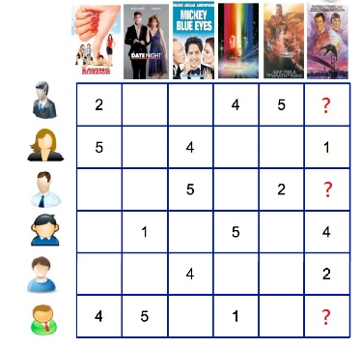
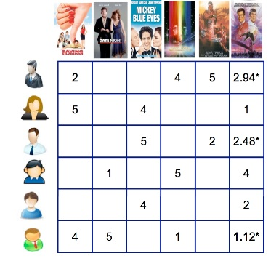
Recommender System
Recommender systems(RS) are software agents that elicit the interests and preferences of individual consumers and make recommendations accordingly.

Slide 2
Dataset for Recommendation
Movies Recommendation
- MovieLens : 100,000 ratings (1-5) from 943 users on 1682 movies and
each user has rated at least 20 movies.
Music Recommendation
- Lasr.fm
Food Recommendation
- Chicago Entrée
More
You can see more different dataset for recommendation from:
https://gist.github.com/entaroadun/1653794

Slide 3




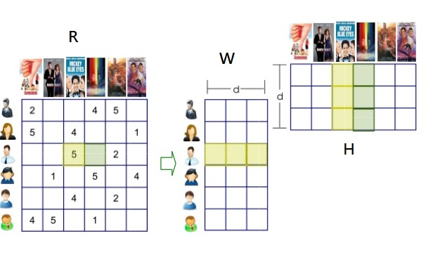
Nonnegative Matrix factorization
NMF factorizes a nonnegative matrix into two nonnegative matrices and such as
for example: is a matrix of users and ratings
represents user feature matrix
represents movie feature matrix

Slide 4
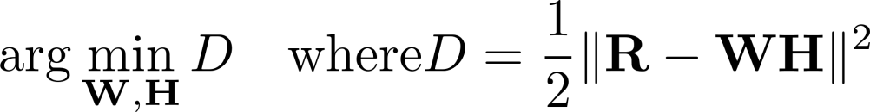
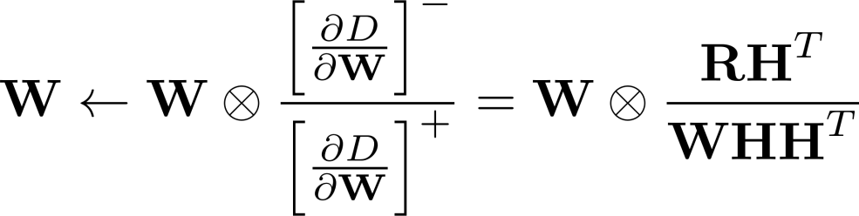
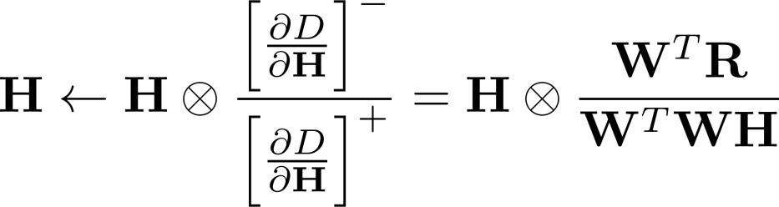
NMF updating rules
Minimize Euclidean distance:
Use multiplicative updating rules for and

Slide 5
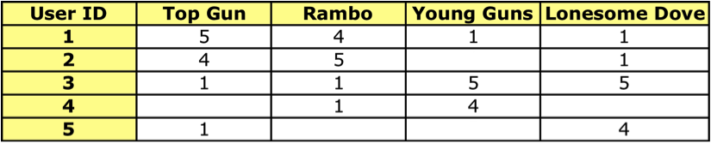
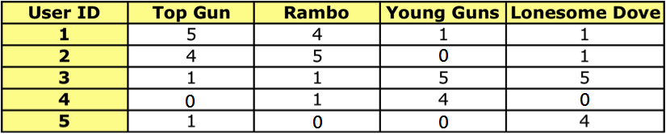
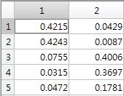
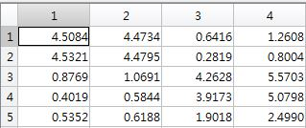


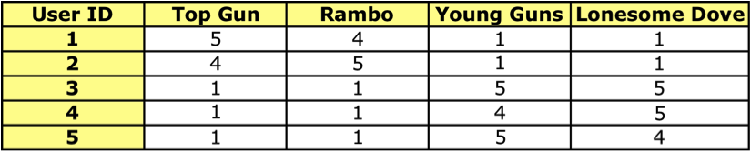

Example for Recommender System
If we have a table of users and rating of movies:
so we can use NMF to train its user and movie feature such as
Original
table :

Slide 6
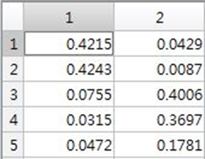
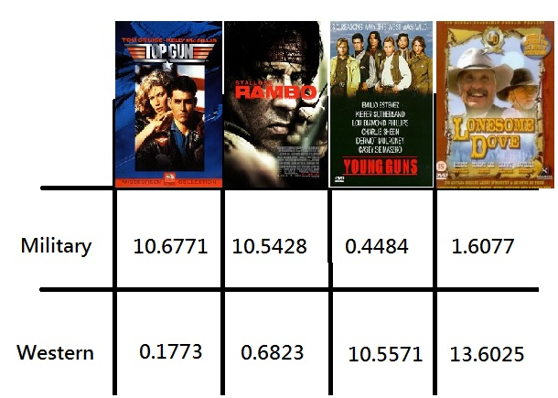
Feature for the example
 | Military | Western
User1 | 0.4215 | 0.0429
User2 | 0.4243 | 0.0087
User3 | 0.0755 | 0.4006
User4 | 0.0315 | 0.3697
User5 | 0.0472 | 0.1781

Slide 7
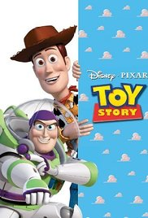

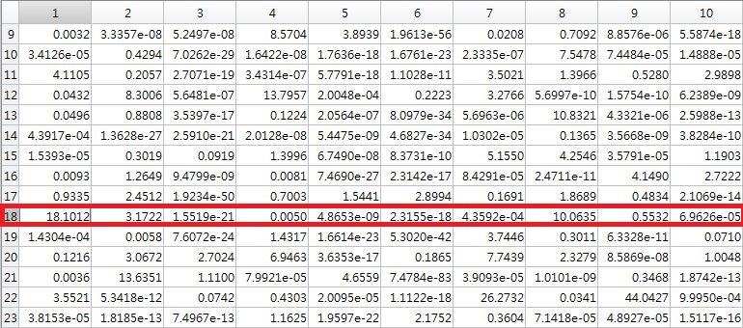
Test for Movies’ features
For example:
movie 1 and 8:
We can see that it is a feature has high weight with both of this movie

